Slide 1

Data Analytics
Project

Slide 2
Team members:
Aya Sobhy
Arwa Osama
Toqa Khaled Desawe
Youssef Maged
Salah Mohammed
Youssef Mohammed Mansour

Slide 3
Agenda:
Dataset attributes
Anomaly detection technique
Preprocessing
Data Exploration(Summary statistics)
Data Visualization
Split data
Predictive techniques

Slide 4
Dataset attributes :
Age: The age of the individual in years.
Workclass: The type of employer or work that the individual is engaged in, such as private, government.
Education: The highest level of education attained by the individual, such as high school, college, or graduate school.
Education-num: The number of years of education completed by the individual.
Marital-status: The marital status of the individual, such as married, divorced, or single.
Occupation: The type of job or occupation held by the individual, such as management, sales, or service.
Relationship: The relationship of the individual to the household, such as spouse, child, or other relative.
Race: The race of the individual, such as White, Black, or Asian.
Sex: The gender of the individual, either male or female.
Capital-gain: The amount of capital gain earned by the individual.
Capital-loss: The amount of capital loss incurred by the individual.
Hours-per-week: The number of hours worked per week by the individual.
Native-country: The country of origin of the individual.
Income: The target variable, indicating whether the individual's income is above or below a certain threshold.
fnlwgt: A weight assigned to each individual in the dataset, which can be used to adjust for sampling bias.

Slide 5
Objective:
The objective of this dataset is to predict whether an individual's income is above or below $50,000 based on their age.

Slide 6
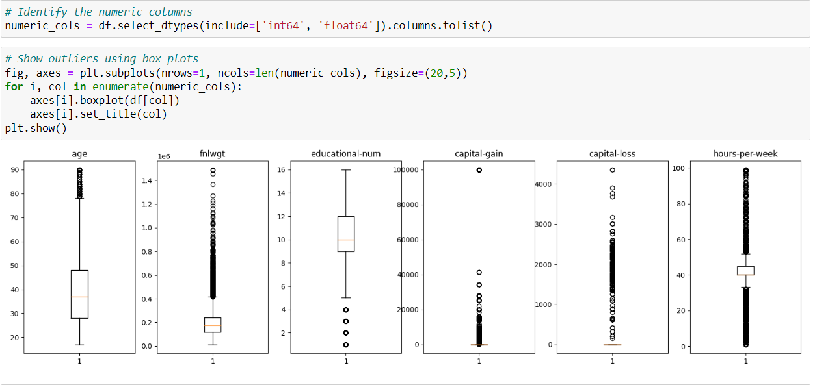
Anomaly Detection
1-Show box plot before remove outliers.

Slide 7
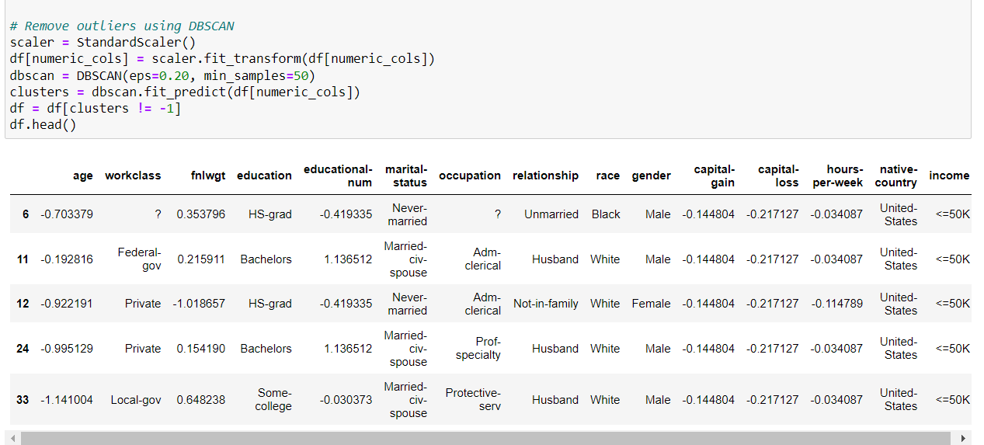
Anomaly Detection
2-remove outliers by using DBSCAN algorithm.

Slide 8
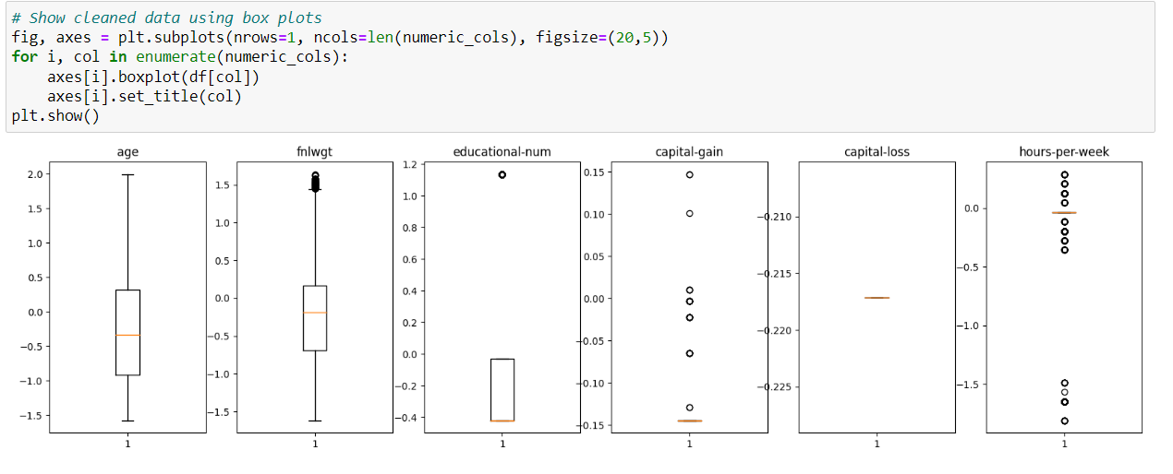
Anomaly Detection
3-show box plot after remove outliers

Slide 9
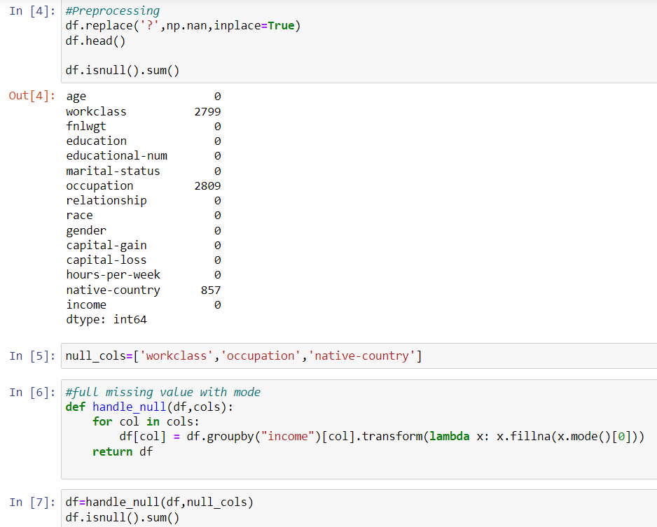
Preprocessing:
1- Replace all ? In data to NULL.
2-Make function to hundle null values and fill with mode.
3-Check duplicate row and drop it.

Slide 10
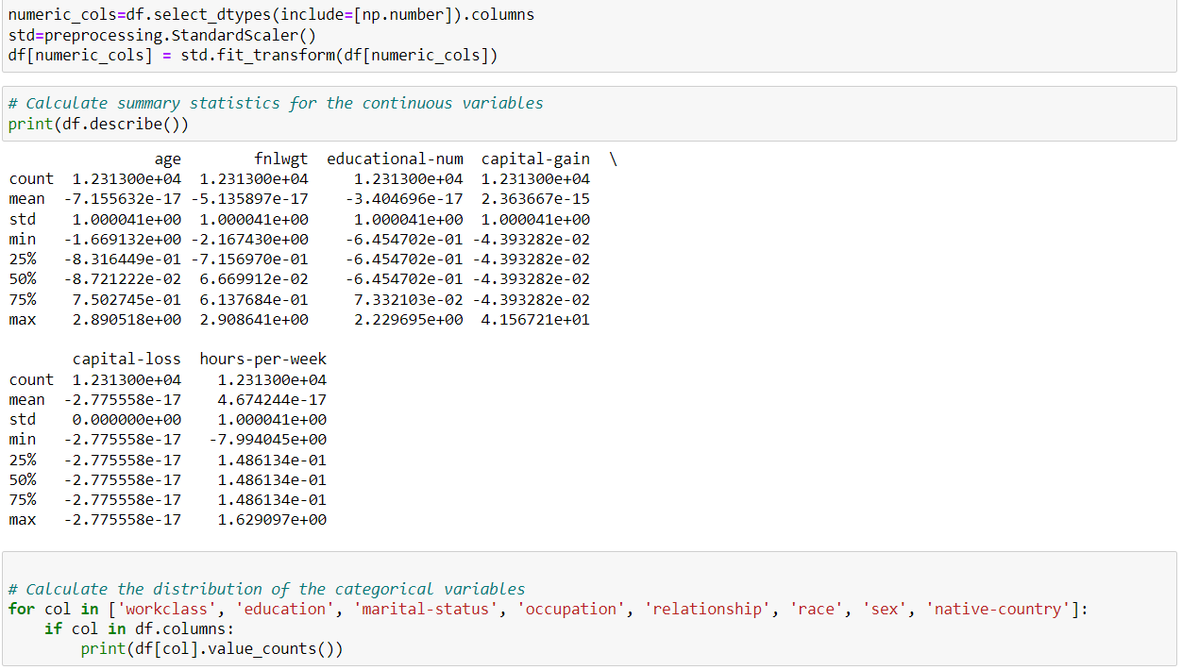
Preprocessing
4- use StandardScaler() to standardize the feature of data set.
5-describe data after standardization.
6-calculate distribution of categorical variables.

Slide 11
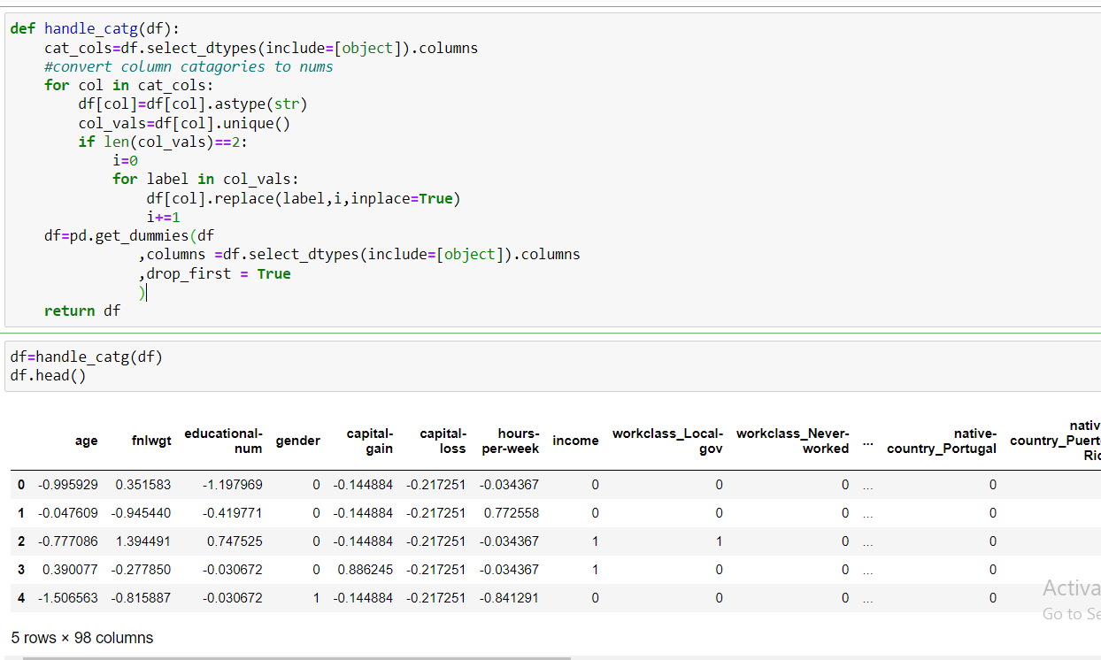
Preprocessing
7-Convert all catergorical data to numircal data

Slide 12
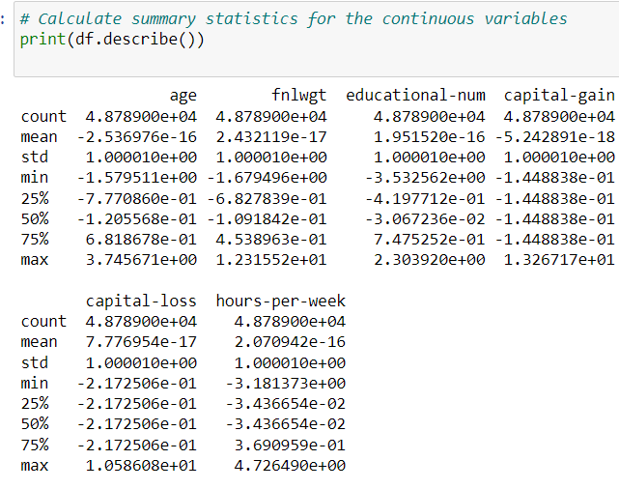
Data Exploration (Summary statistics)
1-use describe function to calculate count,mean,std,min&max.

Slide 13
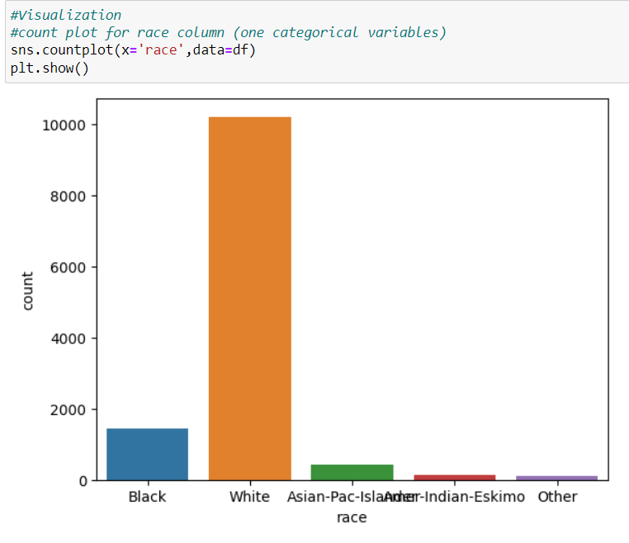
Data Visualization
One Cateorical variable
1-make count plot for race column to show the count of every type (black , white , Asian,….)of race
Result→the white race has the largest count.

Slide 14
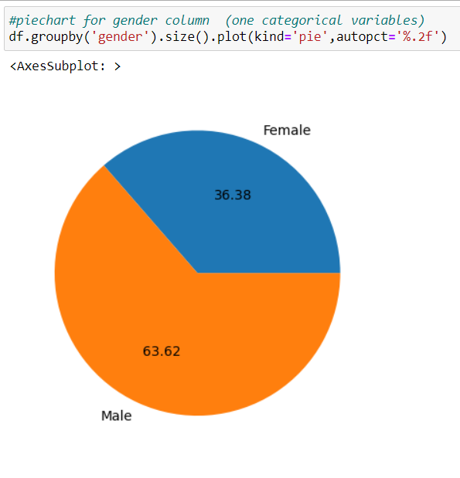
Data Visualization
One Cateorical variable
2-make pie chart to show percentage between female and male .
Result→The percentage of male is larger than female.

Slide 15
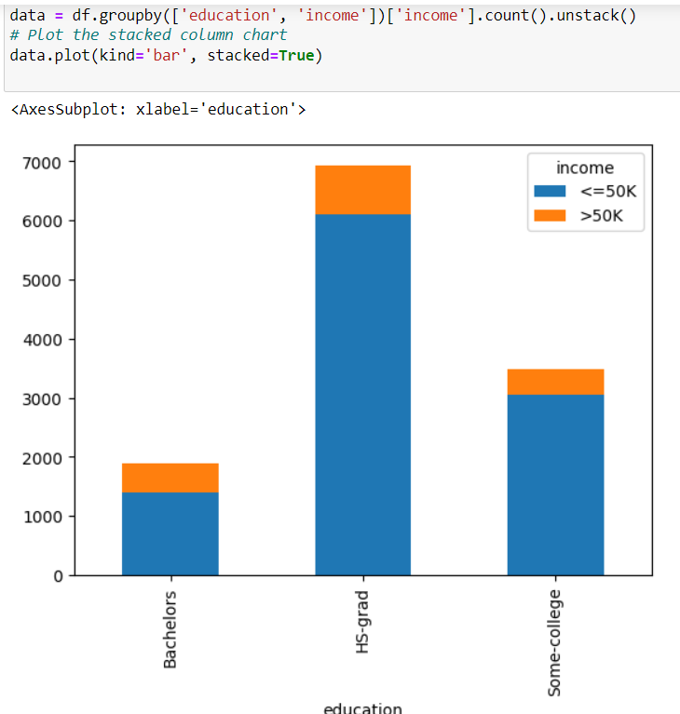
Data Visulization
Two Categorical variables
3-Group the data by the "education" and "income" columns and make stacked column chart to show the relation between education(Bachelors , Hs-grade, some college) and income (target column).
result → the Hs-grade the highest column in 2 cases of income (<=50K,>50K).

Slide 16
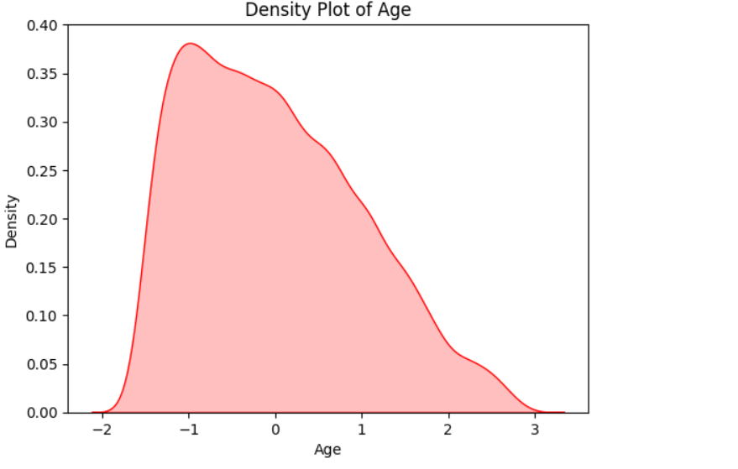
Data Visualization
One Numerical variable
4-make density plot in age column , in this graph interval of age is[-2,3] .
Result→the largest point at age -1.

Slide 17
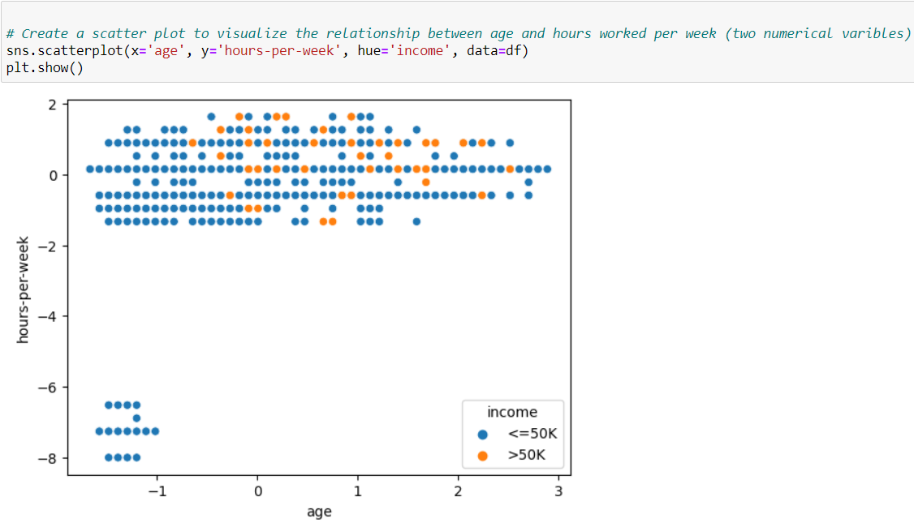
Data Visualization
Two Numerical variables
5-make scatter plot to visualize the relationship between age and hours worked per week , the blue points mean income <= 50K and orange points mean income > 50K.
The result→ people has income <=50K work hours per week more than people has income > 50K.

Slide 18
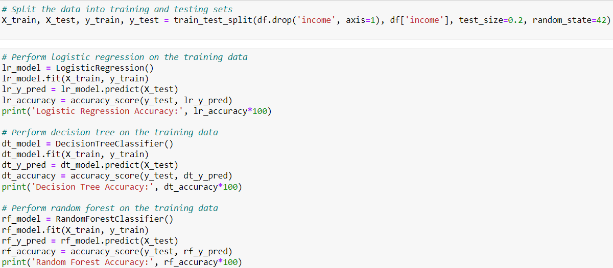
Split data int0 20% test and 80% train

Slide 19
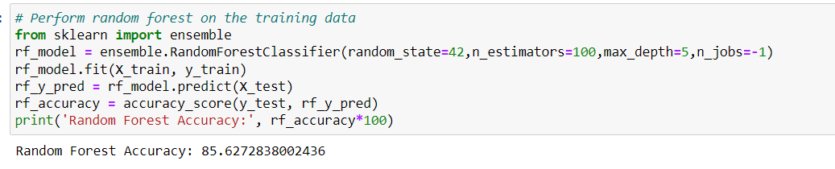
Predictive techniques
1-Random forest algorithm with accuracy 85.62%.

Slide 20
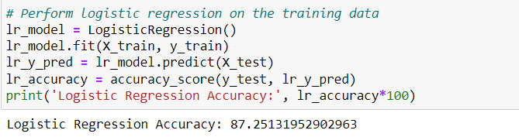
Predictive techniques
2-make logistic regression with accuracy 87.25%.
(This model has the highest accuracy because logistic regression used in binary classification problems).

Slide 21
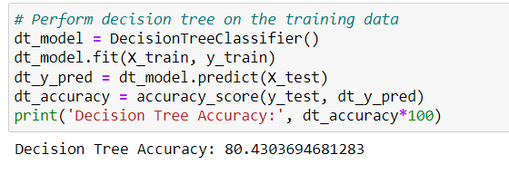
Predictive techniques
3-make decision tree with accuracy 80.43%.

